Slide 1
Introduction to statistics
Maja Kuzman
University of Zagreb, Faculty of Science, Department of Biology
Bioinformatics group
Notes:
How many of you heard some statistics before? How many of you can say they are good with it?
Unfortunately there is no easy way to learn statistics. It is a large field with wide applications and it is easy to misuse it, wether intentionally or no. This is why I chose to show what can go wrong if you misuse statistics. I am only doing this as a motivation for you to understand what is happening when you are applying statistics, instead of using a cookbook and drawing conclusions from the tests you make.
…
In the first part, I will show you what not to do in general, then we will go from the beginning and have a few exercises in R. I will explain most common mistakes and hope that after the workshop today you will have in mind that statistics is more then formulas.
…

Slide 2
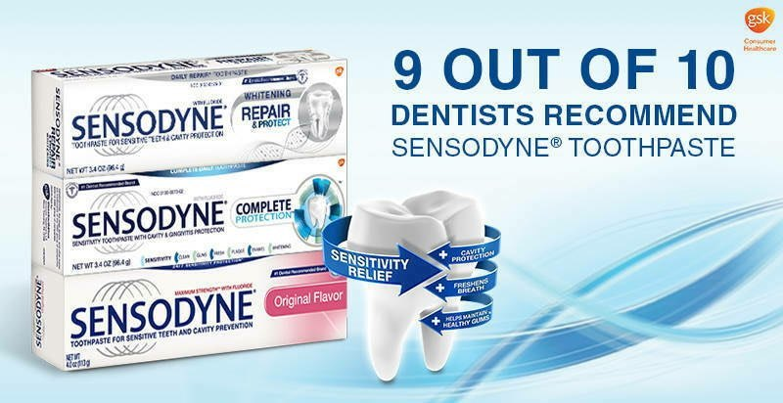

Slide 3


Slide 4
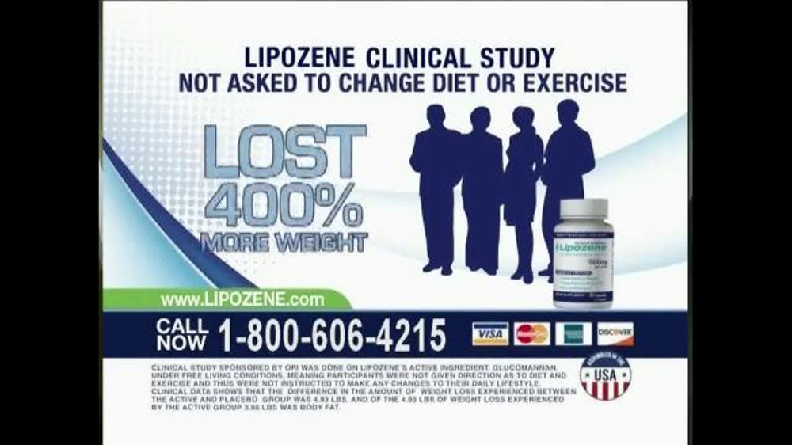

Slide 5
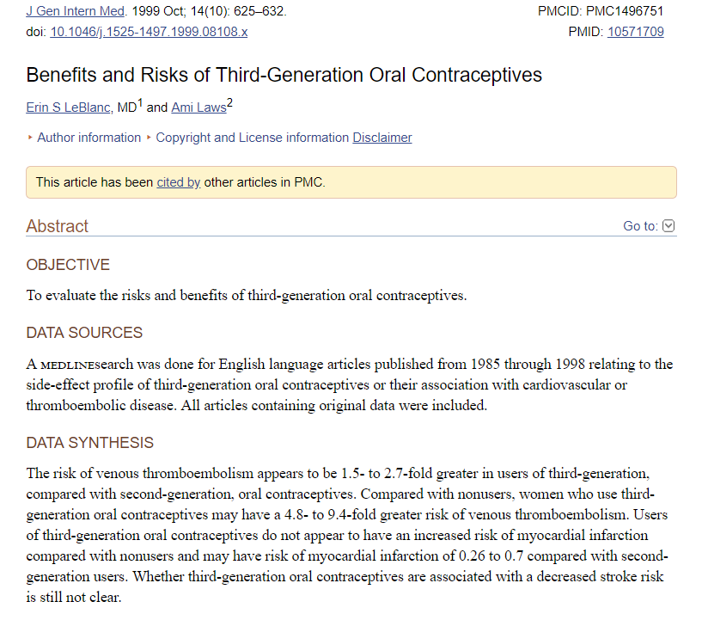

Slide 6

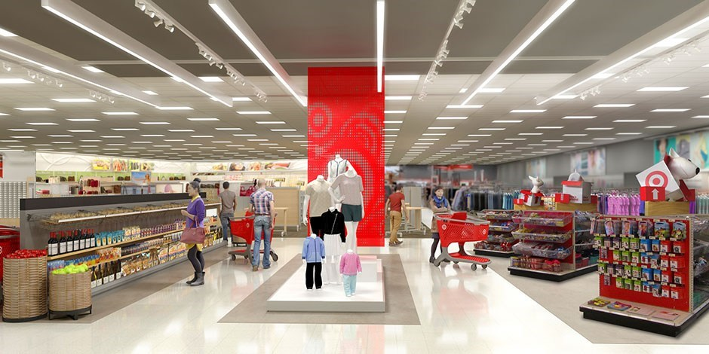
Some famous examples
Notes:
Targer, nytimes: https://www.nytimes.com/2012/02/19/magazine/shopping-habits.html?pagewanted=1&_r=1&hp
There are, however, some brief periods in a person’s life when old routines fall apart and buying habits are suddenly in flux. One of those moments — the moment, really — is right around the birth of a child, when parents are exhausted and overwhelmed and their shopping patterns and brand loyalties are up for grabs. But as Target’s marketers explained to Pole, timing is everything. Because birth records are usually public, the moment a couple have a new baby, they are almost instantaneously barraged with offers and incentives and advertisements from all sorts of companies. Which means that the key is to reach them earlier, before any other retailers know a baby is on the way. Specifically, the marketers said they wanted to send specially designed ads to women in their second trimester, which is when most expectant mothers begin buying all sorts of new things, like prenatal vitamins and maternity clothing. “Can you give us a list?” the marketers asked.

Slide 7
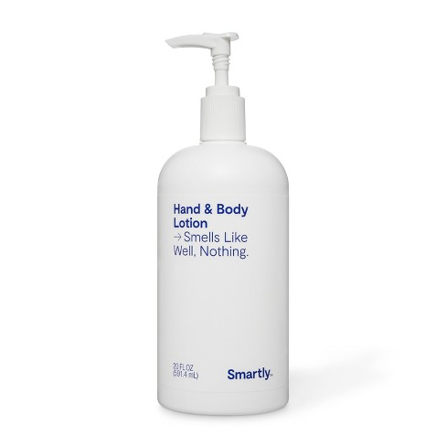
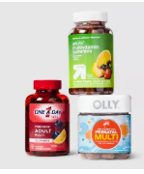
Some famous examples
Notes:
Targer, nytimes: https://www.nytimes.com/2012/02/19/magazine/shopping-habits.html?pagewanted=1&_r=1&hp
There are, however, some brief periods in a person’s life when old routines fall apart and buying habits are suddenly in flux. One of those moments — the moment, really — is right around the birth of a child, when parents are exhausted and overwhelmed and their shopping patterns and brand loyalties are up for grabs. But as Target’s marketers explained to Pole, timing is everything. Because birth records are usually public, the moment a couple have a new baby, they are almost instantaneously barraged with offers and incentives and advertisements from all sorts of companies. Which means that the key is to reach them earlier, before any other retailers know a baby is on the way. Specifically, the marketers said they wanted to send specially designed ads to women in their second trimester, which is when most expectant mothers begin buying all sorts of new things, like prenatal vitamins and maternity clothing. “Can you give us a list?” the marketers asked.

Slide 8
Misuse of statistics
Sometimes others are fooling you

Slide 9

Some famous examples
People v. Collins
1964.
Juanita Brooks:
Blonde Woman
Ponytail
Yellow car
Black man, beard and mustache
= Janet and Malcolm Collins
Notes:
https://law.justia.com/cases/california/supreme-court/2d/68/319.html

Slide 10
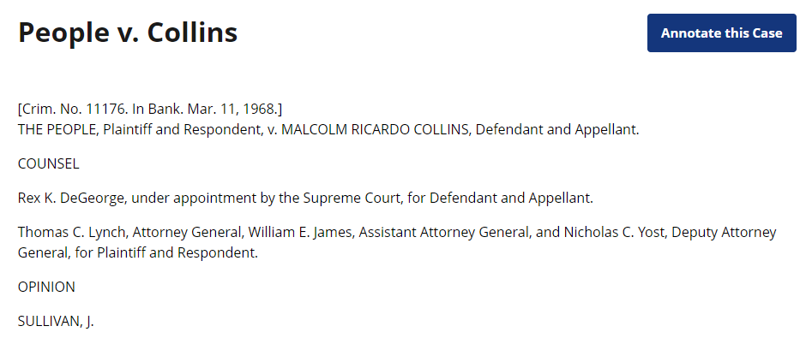
Some famous examples
What are the odds??
White Blonde Woman 1/3
Ponytail 1/10
Yellow car 1/10
Black man, beard 1/10
Man with mustache 1/4
Interracial couple in a car 1/1000
1 in 12 000 000
Notes:
https://law.justia.com/cases/california/supreme-court/2d/68/319.html

Slide 11
Some famous examples
What are the odds??
White Blonde Woman 1/3
Ponytail 1/10
Yellow car 1/10
Black man, beard 1/10
Man with mustache 1/4
Interracial couple in a car 1/1000
1 in 12 000 000 => GUILTY!
Notes:
https://law.justia.com/cases/california/supreme-court/2d/68/319.html

Slide 12
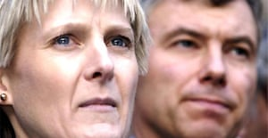
Some famous examples
Sally Clark
1999., murder of 2 sons
Notes:
https://law.justia.com/cases/california/supreme-court/2d/68/319.html

Slide 13
Some famous examples
Sally Clark
1999., murder of 2 sons
What are the odds??
SIDS 1/8543
SIDS 1/8543
TOTAL: ~1/73 000 000
GUILTY
Notes:
https://law.justia.com/cases/california/supreme-court/2d/68/319.html

Slide 14
None of those were right. Bayes theorem.
What are the odds that innocent couple matches these characteristics:
White Blonde Woman 1/3
Ponytail 1/10
Yellow car 1/10
Black man, beard 1/10
Man with mustache 1/4
Interracial couple in a car 1/1000
1 in 12 000 000

Slide 15
None of those were right. Bayes theorem.
What are the odds that the couple which matches these characteristics is innocent???
9/10 =90%

Slide 16
Some famous examples
Prosecutor’s fallacy
Clark's release in January 2003 prompted the Attorney General to order a review of hundreds of other cases.^{[9]} Two other women convicted of murdering their children, Donna Anthony and Angela Cannings, had their convictions overturned and were released from prison. Trupti Patel, who was also accused of murdering her three children, was acquitted in June 2003.
Notes:
https://law.justia.com/cases/california/supreme-court/2d/68/319.html

Slide 17
Sometimes eventhough you think you understand the problem, statistics is causing some biases that are fooling you.

Slide 18
Berkson’s paradox
Why do handsome men / women have bad personalities?
Nice personality
Not so nice
personality
LESS ATTRACTIVE MORE ATTRACTIVE
Notes:
https://www.youtube.com/watch?v=ioxWuCd-mn0

Slide 19
Berkson’s paradox
Why do handsome men / women have bad personalities?
Nice personality
Not so nice
personality
People that wouldn’t date you
People you wouldn’t date
LESS ATTRACTIVE MORE ATTRACTIVE
Notes:
https://www.youtube.com/watch?v=ioxWuCd-mn0

Slide 20
Berkson’s paradox
Why do handsome men / women have bad personalities?
Nice personality
Not so nice
personality
LESS ATTRACTIVE MORE ATTRACTIVE
Notes:
https://www.youtube.com/watch?v=ioxWuCd-mn0

Slide 21
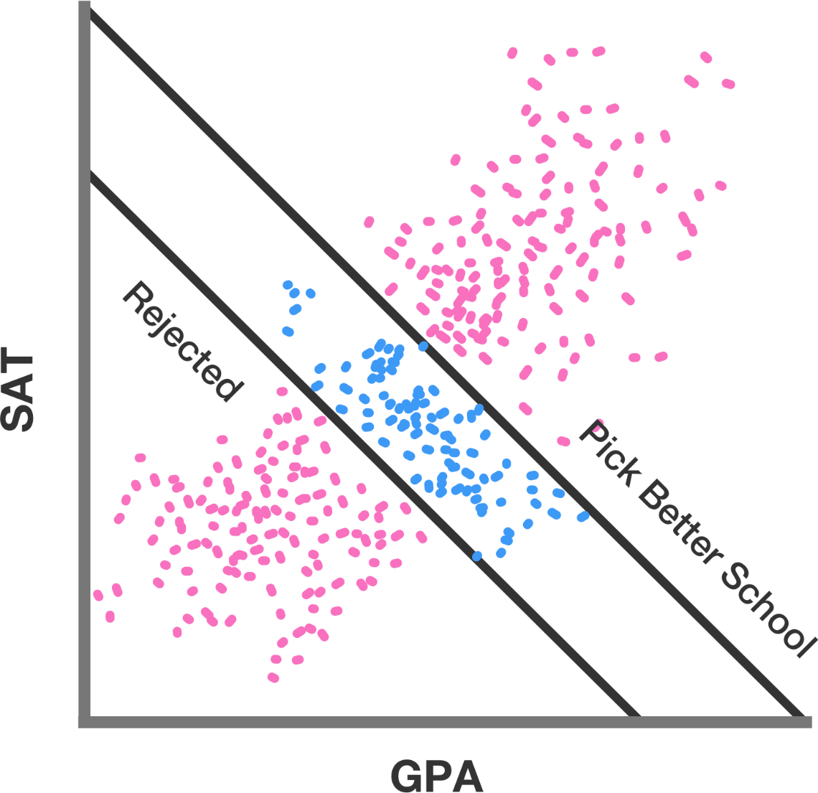
Notes:
https://brilliant.org/wiki/berksons-paradox/
SAT: (in the US) a test of a student's verbal and mathematical skills, used for admission to American colleges.
GPA: grade point average

Slide 22
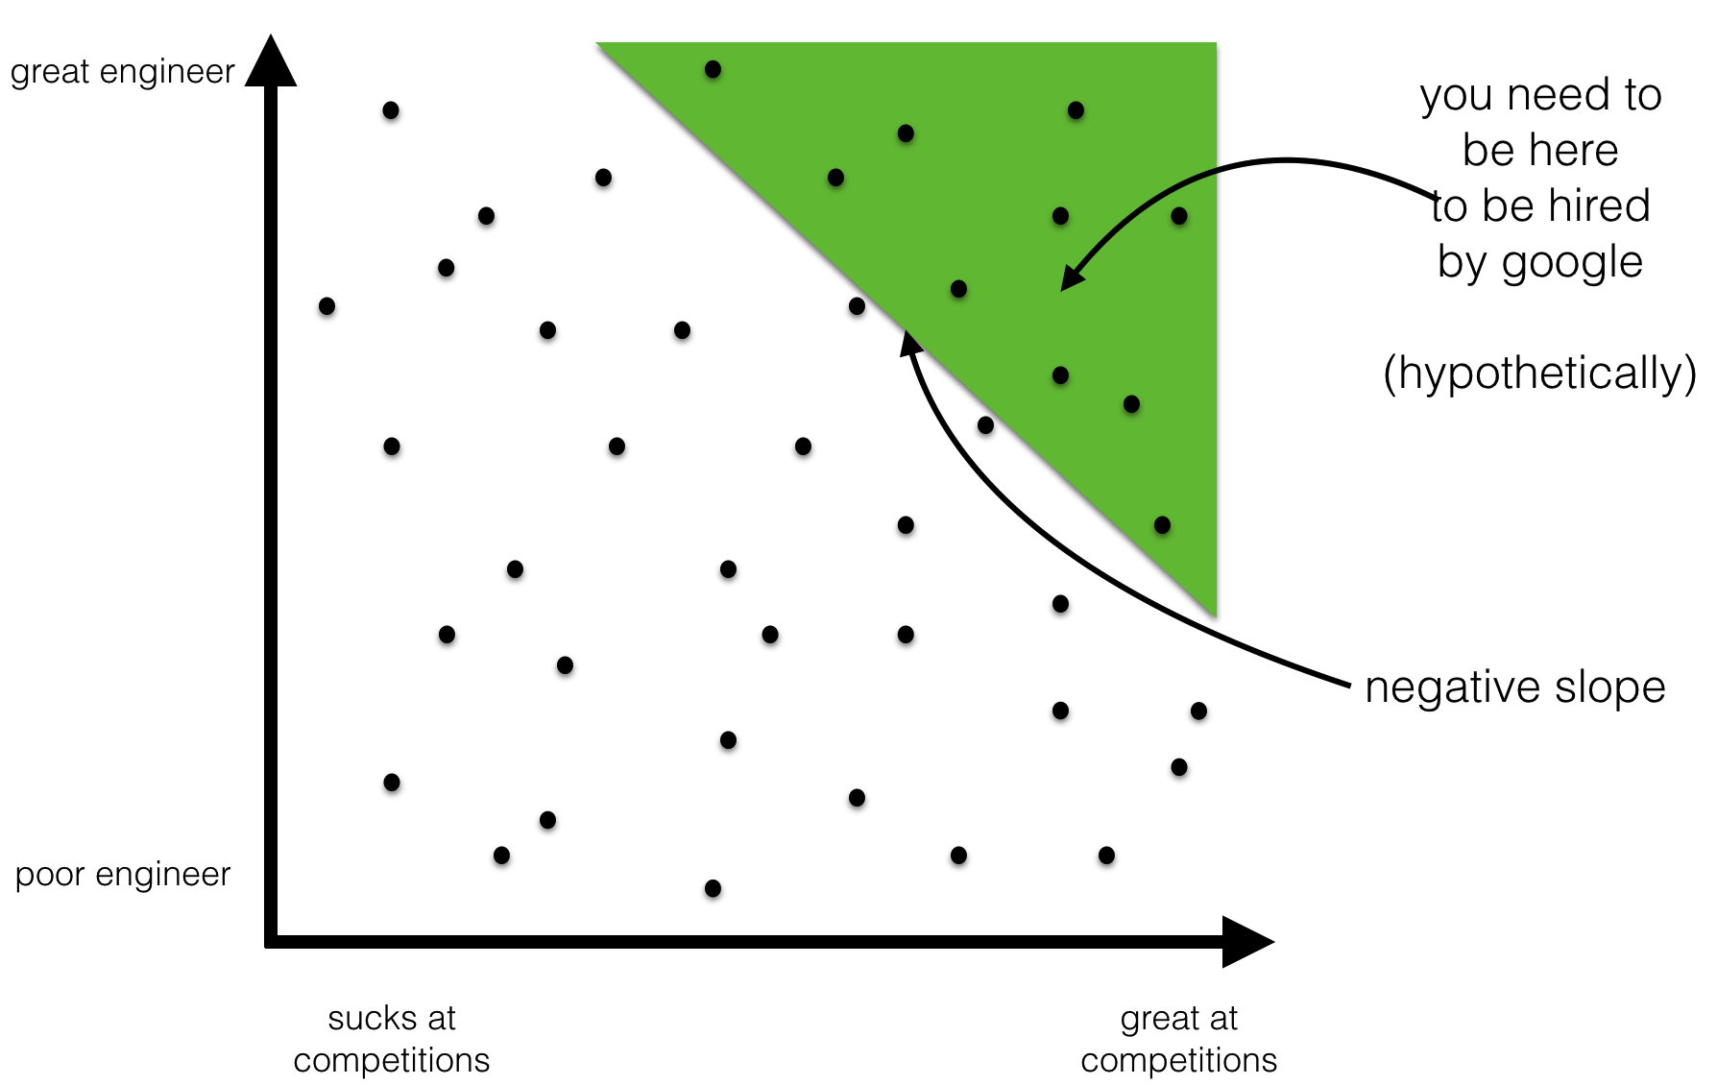
Notes:
https://brilliant.org/wiki/berksons-paradox/
SAT: (in the US) a test of a student's verbal and mathematical skills, used for admission to American colleges.
GPA: grade point average

Slide 23
Now the examples will probably be closer to you being fooled and not even knowing it...

Slide 24
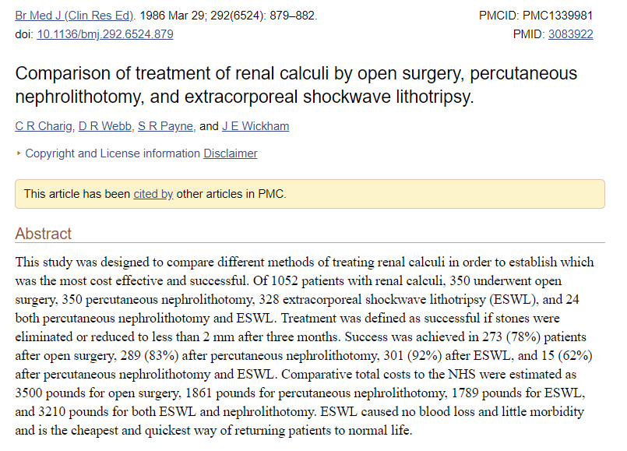
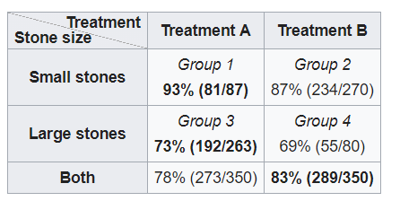
Which treatment is better?

Slide 25
Which treatment is better?

Slide 26
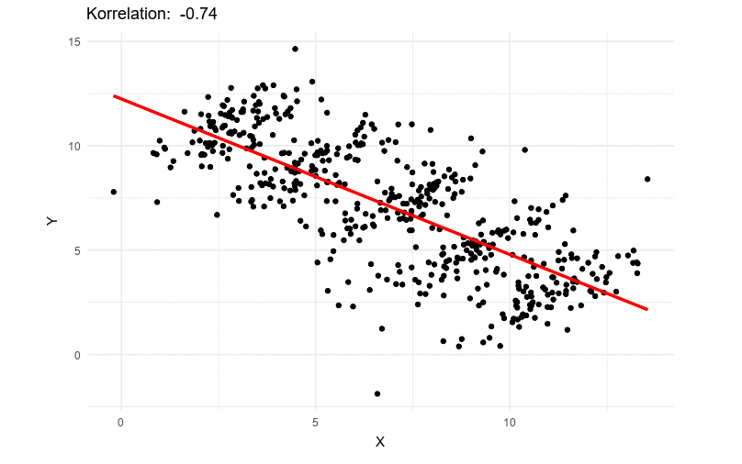
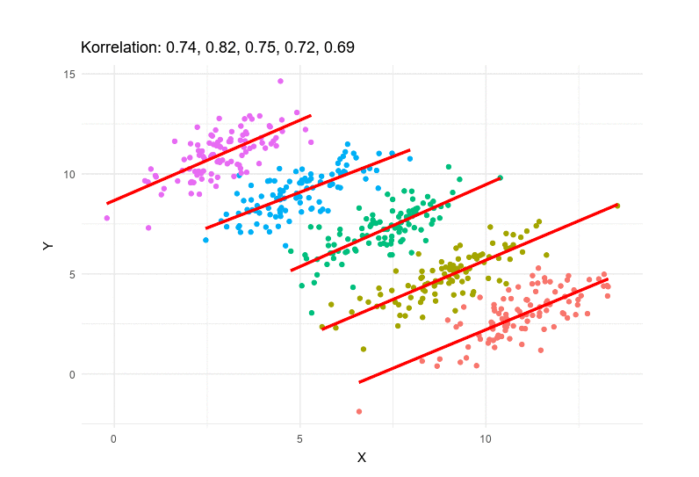
What? Simpson's paradox
Notes:
Wikipedia, https://en.wikipedia.org/wiki/Simpson%27s_paradox

Slide 27
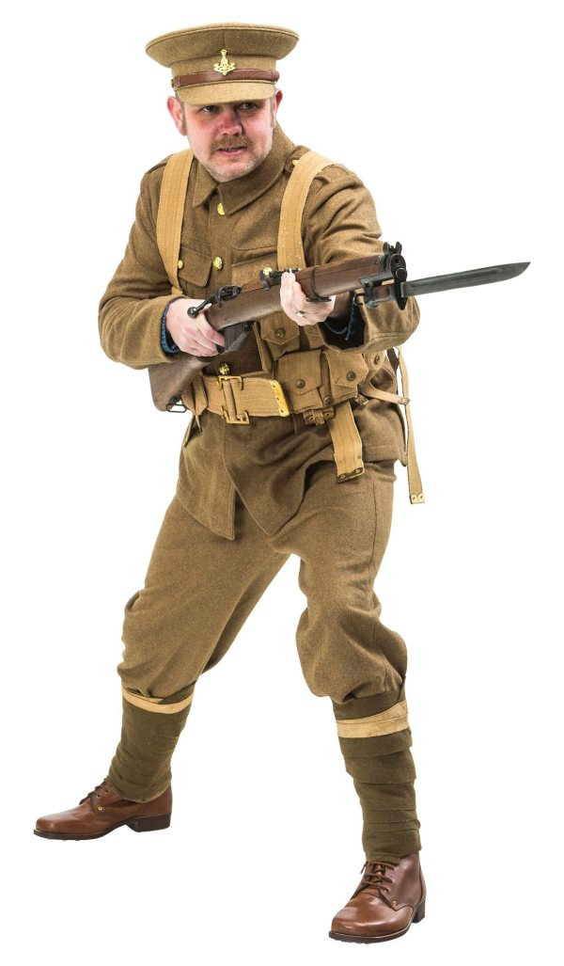
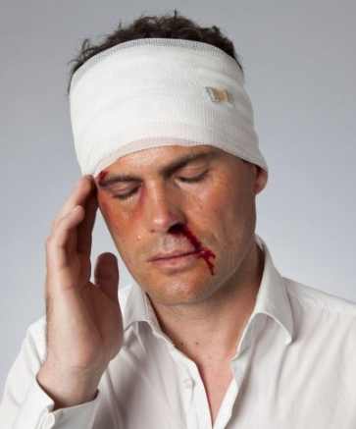
British soldier uniforms in WW1
Notes:
http://www.geom.uiuc.edu/~lori/mathed/problems/problist.html
Do Helmets Increase Head Injuries?
At the beginning of the first World War, the uniform of the British soldiers included a brown cloth cap. They were not provided with metal helmets. As the war went on, the army authorities and the War Office became alarmed at the high proportion of men suffering head injuries. They therefore decided to replace the cloth headgear with metal helmets. From then on, all soldiers wore the metal helmets. However, the War Office was amazed to discover that the incidence of head injuries then increased. It can be assumed that the intensity of fighting was the same before and after this change. So why should the recorded number of head injuries per battalion increase when men wore metal helmets rather than cloth caps?

Slide 28
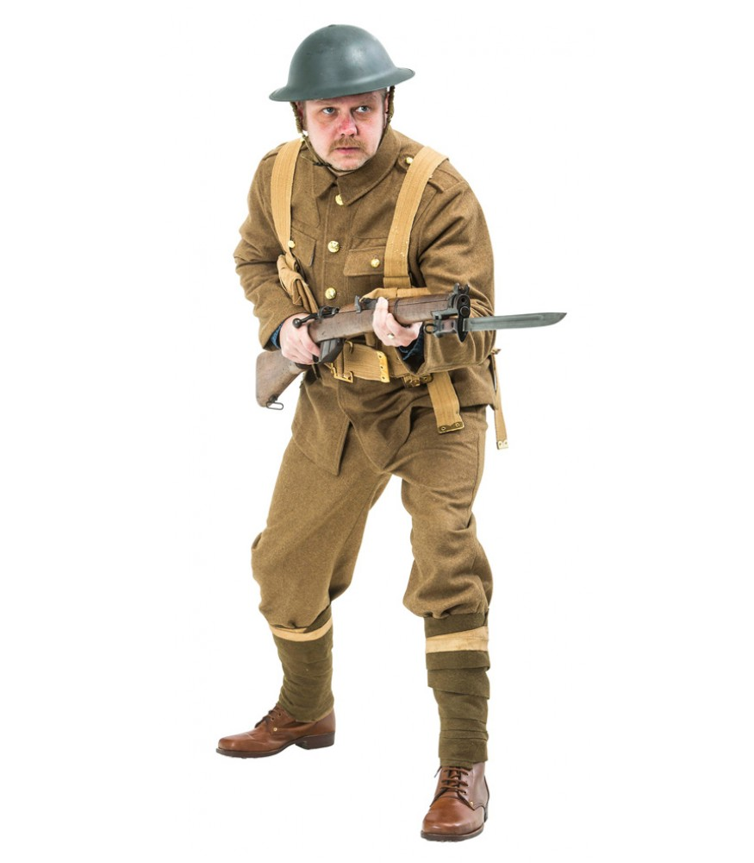
British soldier uniforms in WW1
Notes:
http://www.geom.uiuc.edu/~lori/mathed/problems/problist.html
Do Helmets Increase Head Injuries?
At the beginning of the first World War, the uniform of the British soldiers included a brown cloth cap. They were not provided with metal helmets. As the war went on, the army authorities and the War Office became alarmed at the high proportion of men suffering head injuries. They therefore decided to replace the cloth headgear with metal helmets. From then on, all soldiers wore the metal helmets. However, the War Office was amazed to discover that the incidence of head injuries then increased. It can be assumed that the intensity of fighting was the same before and after this change. So why should the recorded number of head injuries per battalion increase when men wore metal helmets rather than cloth caps?

Slide 29
British soldier uniforms in WW1
Notes:
http://www.geom.uiuc.edu/~lori/mathed/problems/problist.html
Do Helmets Increase Head Injuries?
At the beginning of the first World War, the uniform of the British soldiers included a brown cloth cap. They were not provided with metal helmets. As the war went on, the army authorities and the War Office became alarmed at the high proportion of men suffering head injuries. They therefore decided to replace the cloth headgear with metal helmets. From then on, all soldiers wore the metal helmets. However, the War Office was amazed to discover that the incidence of head injuries then increased. It can be assumed that the intensity of fighting was the same before and after this change. So why should the recorded number of head injuries per battalion increase when men wore metal helmets rather than cloth caps?

Slide 30
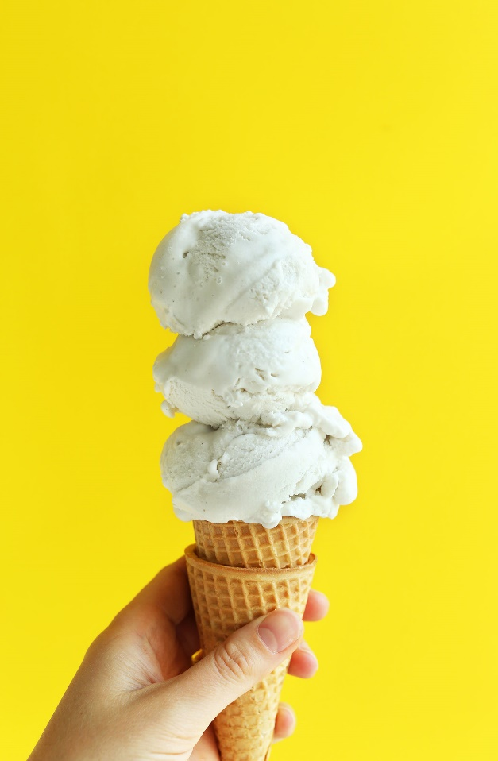

Correlation is not causation

Slide 31
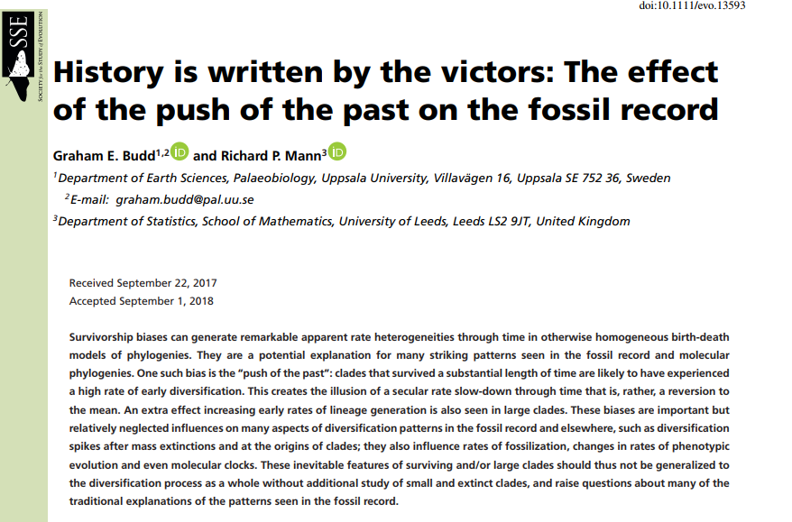
Survivourship bias
Clades that survive a long time are subject to various survivorship biases such as the "push of the past", generating the illusion that clades in general tend to originate with a high rate of diversification that then slows through time

Slide 32
With great power comes great responsibility Let’s start with some basics ☺

Slide 33
Recently you noticed you have more bruises under your knees. Fortunately, you google it and find that some rare disease (1 in a 1000) may cause bruises under the knees. Also, fortunately a commercial appears with a test for this disease. The test is 99% accurate! (False positive rate is 1% and false negative 1%)
Would you buy this test?

Slide 34
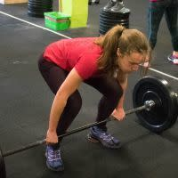
Recently you noticed you have more bruises under your knees. Fortunately, you google it and find that some rare disease (1 in a 1000) may cause bruises under the knees. Also, fortunately a commercial appears with a test for this disease. The test is 99% accurate! (False positive rate is 1% and false negative 1%)
Would you buy this test?

Slide 35
But surely we would never do that..
1/1000 people have the disease. False positive rate is 1% and false negative 1%. The results are: positive. What are the odds that you actually have the disease?
A) 10% B) 50% C) 90% D) 99%

Slide 36
But surely we would never do that..
1/1000 people have the disease. False positive rate is 1% and false negative 1%. The results are: positive. What are the odds that you actually have the disease?
100 000 people
? ?
disease
No disease

Slide 37
But surely we would never do that..
1/1000 people have the disease. False positive rate is 1% and false negative 1%. The results are: positive. What are the odds that you actually have the disease?
100 000 people
100 people 99 900 people
Test?
disease
No disease

Slide 38
But surely we would never do that..
1/1000 people have the disease. False positive rate is 1% and false negative 1%. The results are: positive. What are the odds that you actually have the disease?
100 000 people
100 people 99 900 people
disease
No disease
Test negative
Test positive
Test negative
Test positive

Slide 39
But surely we would never do that..
1/1000 people have the disease. False positive rate is 1% and false negative 1%. The results are: positive. What are the odds that you actually have the disease?
100 000 people
100 people 99 900 people
99 ppl 1ppl 999ppl 98901ppl
disease
No disease
Test negative
Test positive
Test negative
Test positive

Slide 40
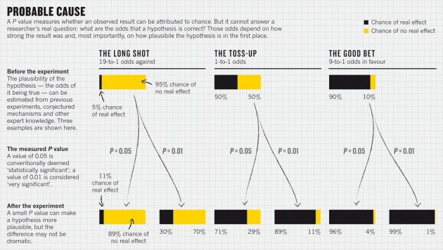

Slide 41
Misuse of statistics
Sometimes you are fooling yourself …

Slide 42
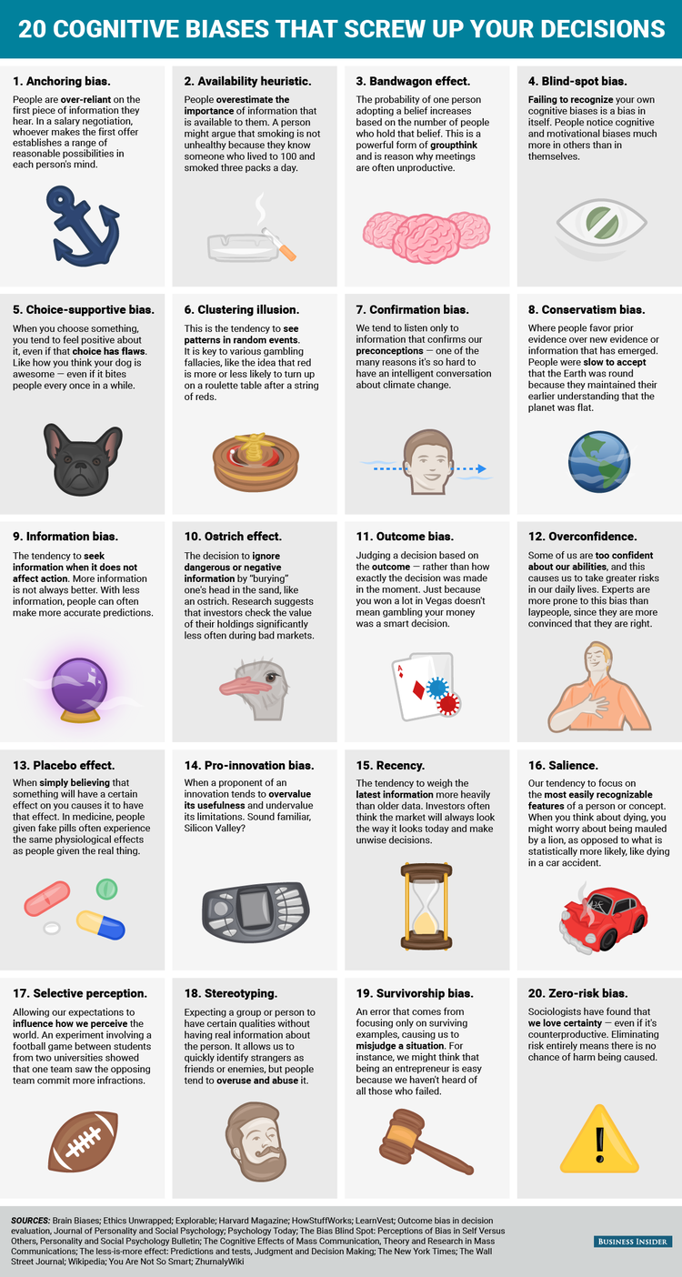
Other types of biases in decision making
Notes:
https://www.businessinsider.com/cognitive-biases-that-affect-decisions-2015-8

Slide 43
Other types of biases in decision making

Slide 44
Other types of biases in decision making

Slide 45
Other types of biases in decision making

Slide 46
Other types of biases in decision making

Slide 47
PLAN FOR TODAY:
9 - 9:45
Lecture: why it is important to understand what you are doing
Motivational examples
9:45 - 12
Workshop: Introduction to statistics
Random variables
Null hypothesis
Normal distribution and central limit theorem
p value
14 - 15
Lecture: How scientists fool themselves and how we can stop
15 – 16
Workshop: Introduction to statistics continued
Non-normal distributions
When to use which test
16:30 – 18
Workshop: Statistical modelling
Linear models
Cross Validation
Bootstrapping

